Slide 1
Commercial

Slide 2

TAXI CO-OP
INTRODUCING…
Frustrated with long waiting time and poor Interface ?
Are you a resident in Bangalore?
Tired of those legacy cab aggregators ?
The advanced cloud-based system in the market
A one stop solution for all your struggles ;)
now available in beta …………

Slide 3
Welcome

Slide 4

CAPSTONE PROJECT
Location based Taxi Aggregator and Selector
Designed and Developed By,
ANKITA SHREYA | ANDLIBMEHNDI NAQVI |  | HARSHIV VIKRAM SHA
SREENATH KIZHEMADAM |  | NISCHITA SHETTY
VIGNESH KUMAR

Slide 5
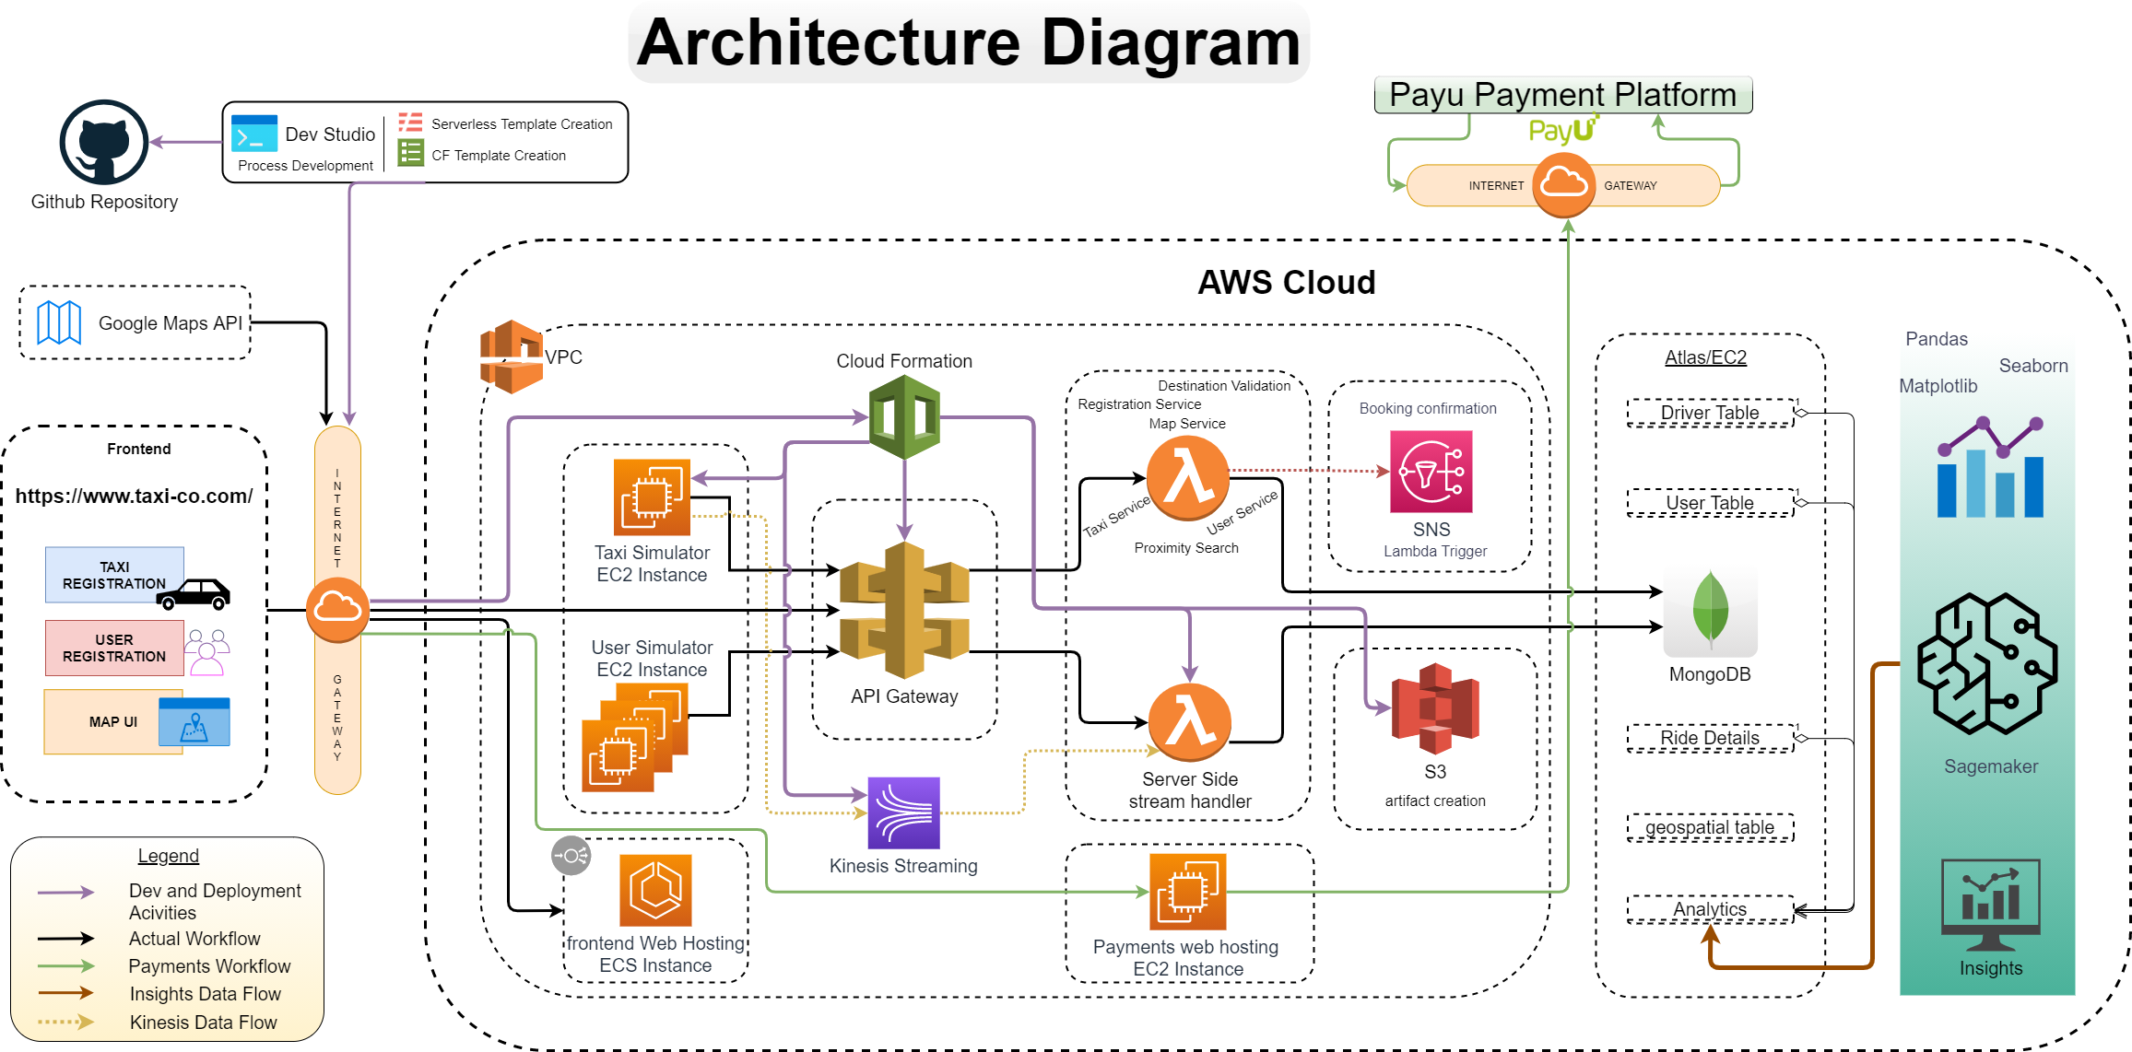

Slide 6
Salient Features
A Microservices based architecture completely built on AWS tech stack for continuous integration and delivery.
MongoDB: A Horizontally scalable NoSQL Database for storing and modelling semi-structured and unstructured data with support for Geospatial Data.
Flutter: A Modern UI toolkit that natively supports cross device capabilities with a single codebase.

Slide 7

Tools, Language and Framework Highlights
Flutter(Dart) - Frontend UI
AWS Lambda & API gateway – Server-side Handlers
MongoDB & Aggregation framework – single NoSQL DB
NodeJS, Python – Languages for Backend system
Google MAPS API – for Directions and geocoding support
Serverless Framework – for template creation and deployment
Matplotlib, Seaborn – Insights Reporting

Slide 8
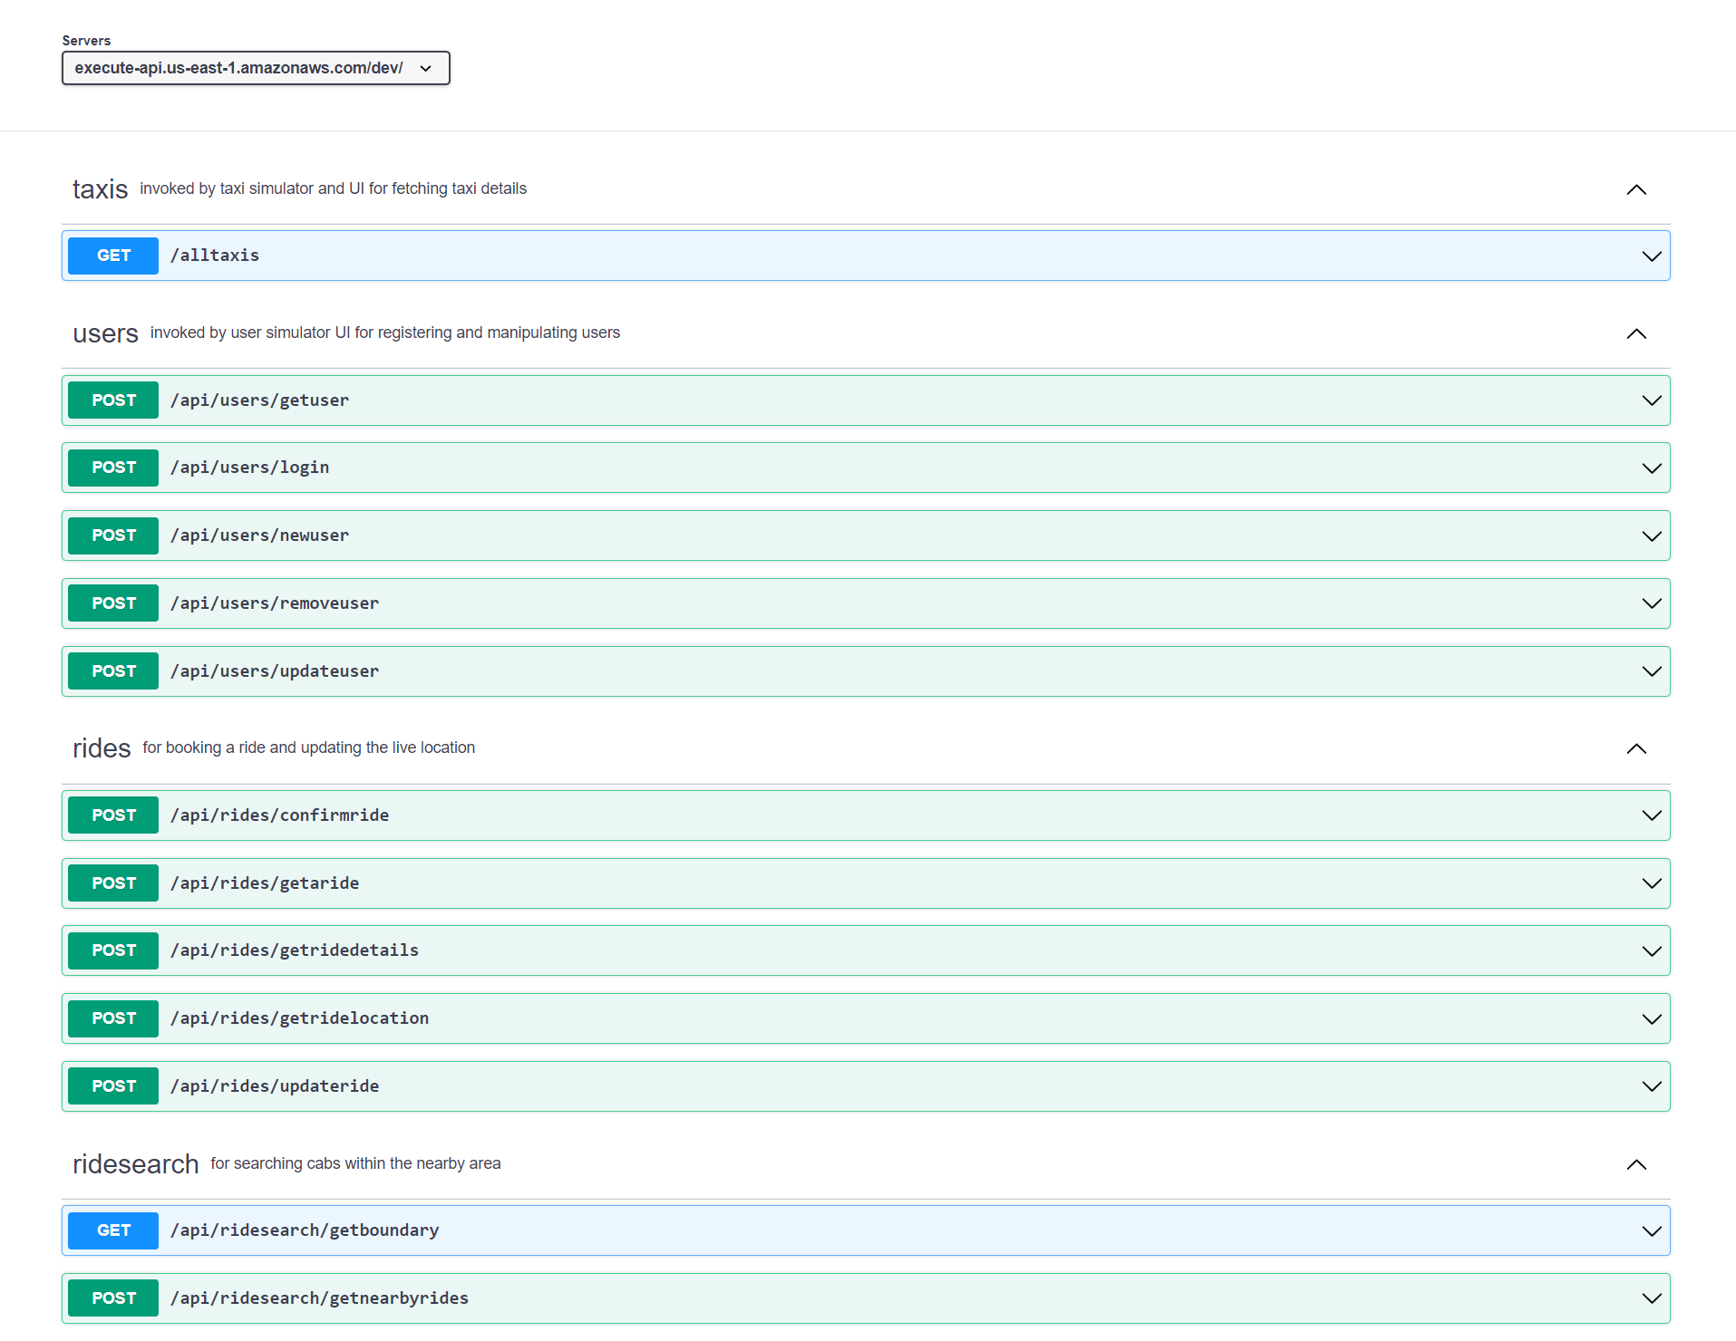
API Endpoints
REST API (Simulator) SEQUENCE DIAGRAM
API-Gateway
API-Calls

Slide 9
Frontend Highlights
Description :
Flutter Web App using Google Maps and making REST API calls to AWS API Gateway storing data into Mongo DB.
Purpose :
Users can do the following:
(Taxi/Passenger) ->uses front end to SignUp, Login.
(Passenger) ->Book taxi, View Rides on map, Give feedback, Pay for ride.
(Taxi) -> View location of passenger, View route.
Tech Stack
Flutter with dart in Android Studio to code the front end (flutter and dart packages include google-maps for flutter web)
AWS API Gateway, AWS Lambda, AWS SNS
Mongo DB Atlas Free tier

Slide 10
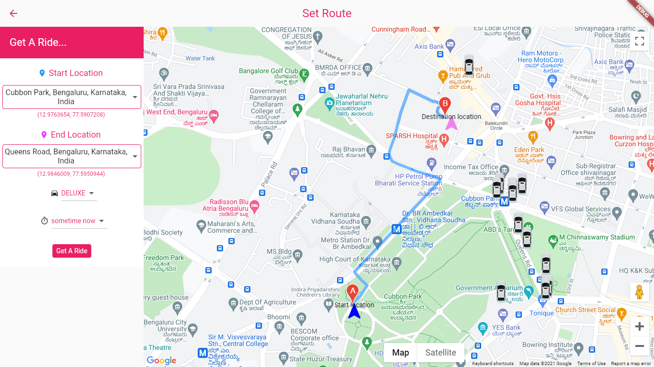
MAP UI

Slide 11
Taxi Simulator Highlights
Purpose - Generate initial random coordinates and then move taxi free in given boundary.
Description - First we need to fetch all taxi list from the database and then generate initial coordinates for all taxi and after that start free movement of taxi at every 1 minute at 500 m distance. Simulator will also assign new coordinates to each taxi by calculating distance given above from previous coordinates. Simulator also keep an eye that taxi will not be able to go outside define boundary. All data will push to kinesis and from there it will trigger lambda function which insert data in database.
Steps to execute - All code reside in EC2 instance, and you just need to run main.py file to start execution of taxi simulator. Give appropriate rights to EC2 (i.e.- Kinesis role) and install external libraries used in simulator.
Scenarios supported -
Taxi initial random location generation within boundary
Move taxi at every 1 min
Generate new coordinates from old coordinates
Validate coordinates within boundary or not
Push data to kinesis
Placeholder INSERT CONSOLE LOGS HERE

Slide 12
User Simulator Highlights
Purpose- User actions to showcase taxi movement and booking scenarios
Description- Taxi Simulator and User Simulators majorly used to simulate Taxi driver and User actions and movements in order to provide user interface like behavior
Steps to execute- Both Taxi Simulators and User simulators are placed in AWS EC machines..
Scenarios supported-
Taxi Simulator supports:
Taxi generation
Taxi Tracking
Taxi movement
User Simulator Supports
User Signup
User Signin
Taxi Booking
Placeholder INSERT CONSOLE LOGS HERE

Slide 13
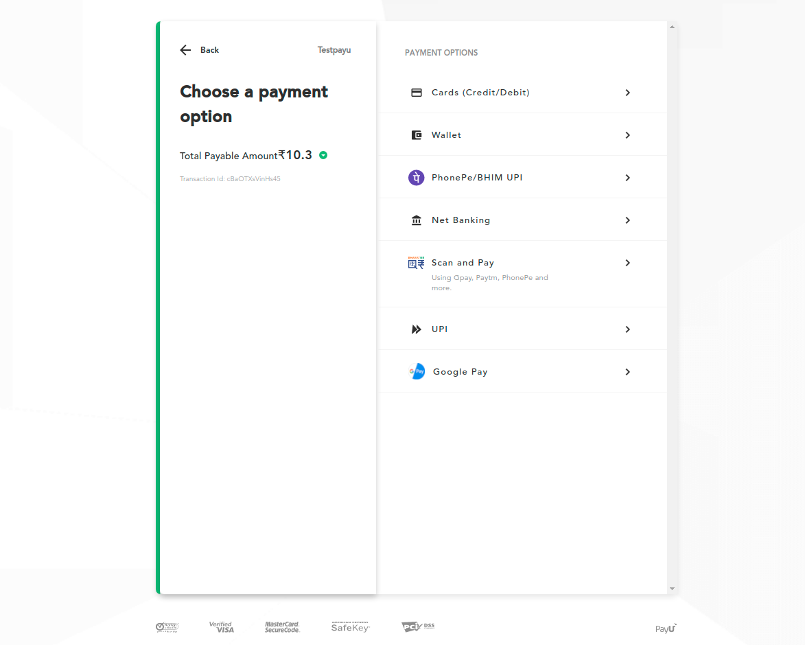

Payment Gateway
Purpose - To initiate the transaction for the customers availing Travel Care services.
Description:
Integrated with PayU’s payment gateway. The payment lambda handler triggers the payment processing via REST endpoints.
PayU provides various payment methods, therefore letting the customers choose as per their convenience.
The transaction is done on the built-in checkout page provided by PayU payment platform

Slide 14
Insights Highlights
Purpose – Acts as an analytics tools that deliver insights for the Organization
Description – Currently provides insights on below Aggregations
Steps to execute - The insights are available via the Jupyter Notebook hosted on the AWS SageMaker
Scenarios supported

Slide 15
References
https://flutter.dev/docs
https://flask.palletsprojects.com/en/2.0.x/
https://nodejs.org/api/
https://docs.aws.amazon.com/lambda/index.html
https://docs.mongodb.com/manual/
https://www.practical-mongodb-aggregations.com/
https://seaborn.pydata.org/api.html
https://pandas.pydata.org/docs/reference/index.html
https://devguide.payu.in/docs/developers-guide/

Slide 16


Our sincere thanks to the faculties of IIT-Madras and Great Learning.

Slide 17

Q & A

Slide 18
Thank You

